Slide 1

Web Scraping in Python
Atta Muhammad

Slide 2
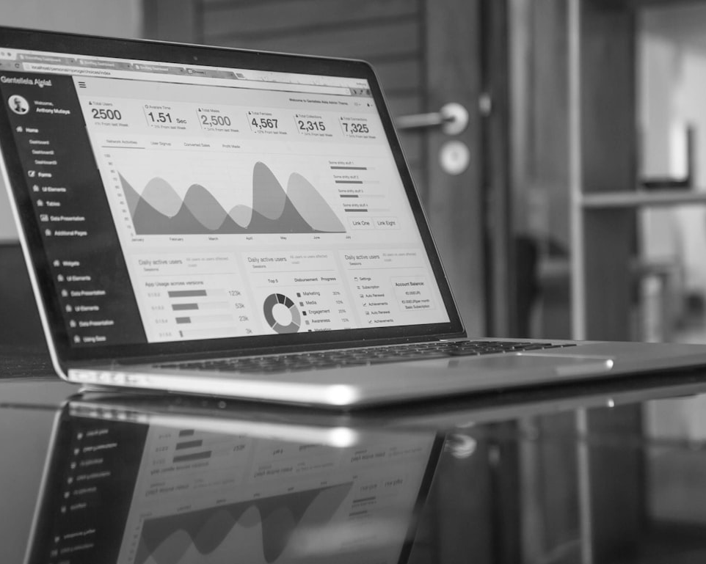
Introduction to Scraping
Understanding Web Scraping
Web scraping is the automated process of extracting information from websites. It is crucial for data analysis, market research, and competitive intelligence.

Slide 3
Key Libraries Overview
This table provides an overview of popular Python libraries used for web scraping, detailing their specific purposes and typical applications.
Library | Description | Usage
Beautiful Soup | HTML parsing and extraction | For navigating HTML/XML documents
Scrapy | Full-fledged web scraping framework | For large-scale scraping projects
Requests | Simplifies HTTP requests | For sending and managing requests easily
Selenium | Browser automation | For scraping JavaScript-heavy websites
Pandas | Data manipulation and analysis | For handling and analyzing scraped data

Slide 4
Basic Scraping Techniques
HTML Parsing Methods
Web Automation Techniques
Utilize libraries like Beautiful Soup for parsing HTML. This enables the selection and extraction of data using CSS selectors or XPath.
Employ Selenium for dynamic content. This simulates user interactions, enabling the scraping of websites reliant on JavaScript.

Slide 5
Handling Data
Storing and Manipulating Data
Data from web scraping needs effective storage and manipulation. Use formats like CSV or databases like SQLite for structured storage. Pandas enables easy data manipulation for analysis.

Slide 6
Ethics and Compliance
Understanding Ethical Considerations
Ensure scraping is compliant with a website's Terms of Service. Respect for user privacy and avoiding excessive requests are vital.
Legal Compliance
Familiarize yourself with legal frameworks governing data scraping. Abide by laws like the Computer Fraud and Abuse Act and local data protection regulations.

Slide 7
Future Trends
45%
30%
25%
Higher Automation
Artificial Intelligence
Privacy Regulations
More organizations will adopt automated scraping tools to enhance efficiency.
Integration of AI for smarter data extraction and processing.
Growing regulations will influence scraping practices.

